Slide 1

KAIZEN Report-Out Standards
Rev - March 23rd, 2025

Slide 2






Kaizen Report-Out Guidelines
All Kaizen team members must present & be on stage
Senior Leadership Involvement
Some members may resist public speaking, so they should just introduce themselves at the beginning of the presentation. Do not let one member dominate the presentation!
LHC CONSULTANT DOES NOT PRESENT! (except for closing remarks)
Senior leadership should be invited to attend the Kaizen Report-Out presentation well in advance of the event.
Presentation Specifics
Report-out Timing
Total presentation per team: 30 Minutes as follows:
20 Minutes - Team Presentation
10 Minutes - Q&A/Discussion - Questions should be held to this portion of the agenda.
Use visuals as much as possible.
Must be done at the conclusion of the Kaizen event, not later.
Report-Out Preparation
Celebrate
Team members should prepare the Kaizen Report-Out presentation. Presentation should be in electronic format so that it could be shared with others subsequent to the Kaizen event.
Be sure to congratulate the team at the conclusion of the presentation. Celebrate with a pizza party, ice cream, etc.

Slide 3
Anatomy of a Kaizen Report-Out
All Kaizen Report-Outs Must Contain These Elements
1
2
3
4
5
6
Team Introduction
Kaizen Charter
& Agenda
Kaizen Improvements
Kaizen
Documentation
& Results
Kaizen Newspaper
Lessons Learned & Parking Lot
Must contain the Team name, team members’ names & titles, photo of the team
The Charter and Agenda is a key element to Kaizen preparation and needs to be complete well before the Kaizen event. Sr. Consultants must obtain approval from their Managing Director. See separate guidelines on how to properly prepare a Kaizen Charter and Agenda.
Must provide BEFORE/AFTER photos, diagrams, etc.
Documentation to be applicable to the type of Kaizen event.
Details follow-up items and activity with timelines and responsibilities
Opportunity for team members to showcase their learnings
Future actions outside the scope of the Kaizen Newspaper
Details the current KPI, achieved KPI, and Kaizen target for each KPI in respect to the targets outlined in the Kaizen Charter (Step #2)
See the following sections for detailed descriptions and examples

Slide 4

Team Introduction
1
Team Laser Focus
Pictured L to R:
Bill Wilson - VP Operations
Mary Smith - Production Operator
Bill Chen - Production Control Coordinator
Samantha Rayburn - Manufacturing Engineer
Jim Sanders - Staff Accountant

Slide 5
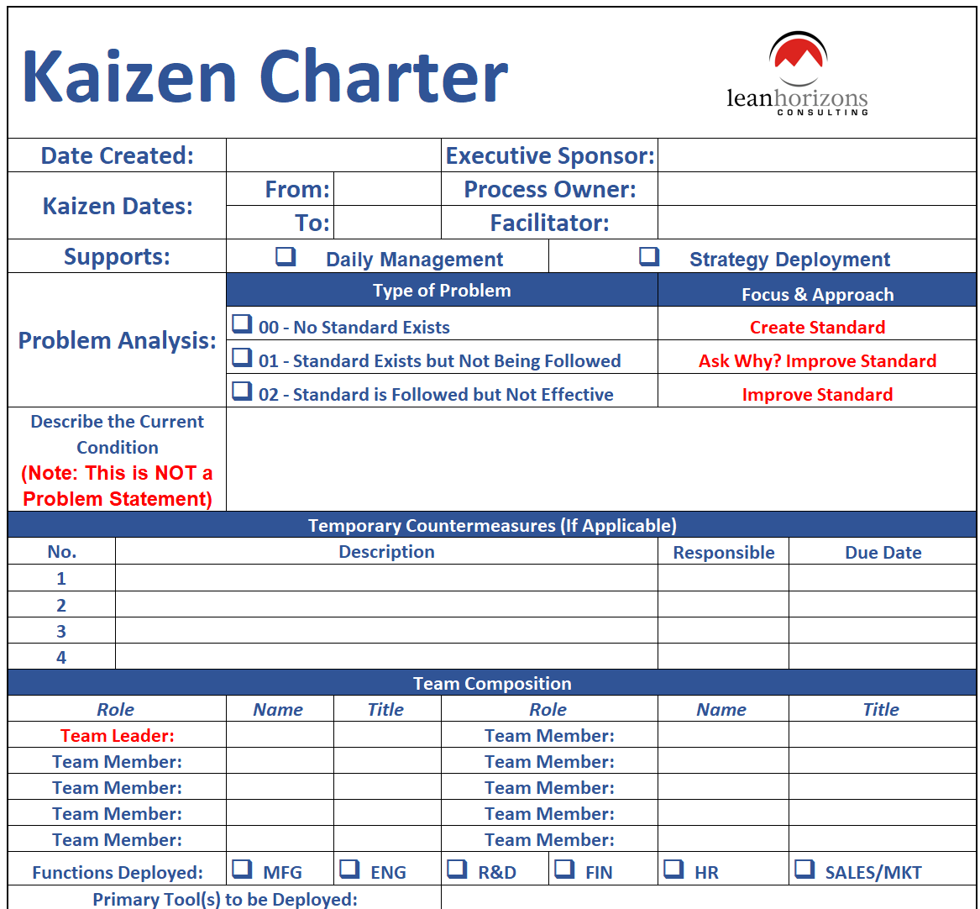
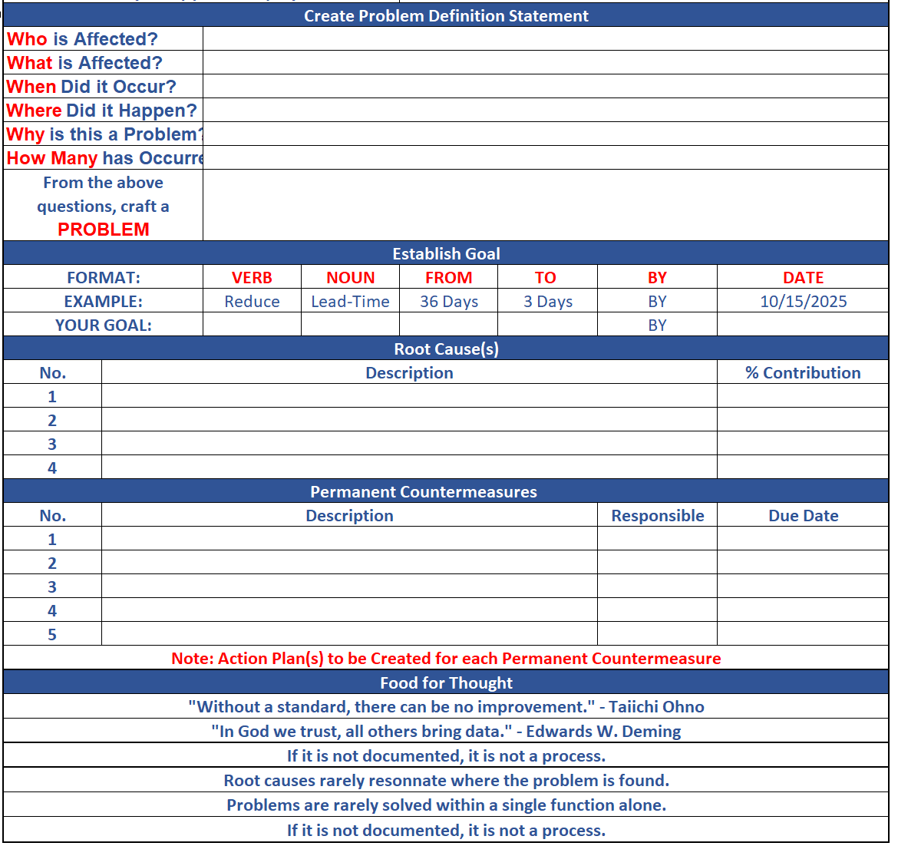
Kaizen Charter
2

Slide 6
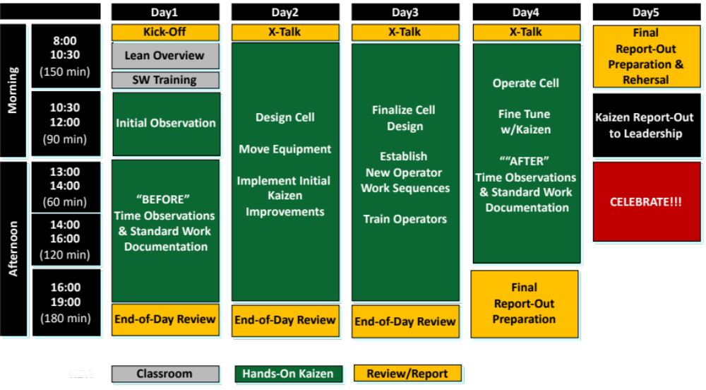
Kaizen Sample Agenda
2

Slide 7
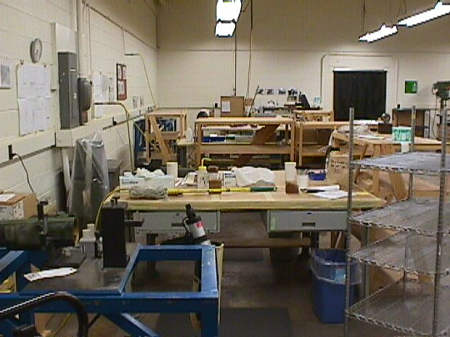
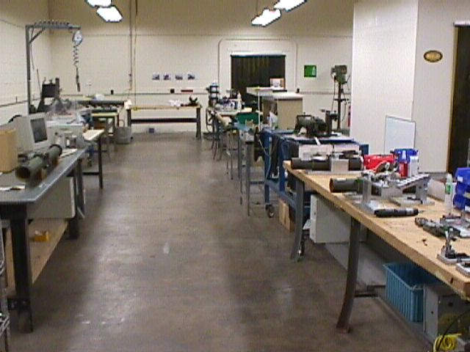
Kaizen Improvements - Sample
3
Process: Assembly Cell | Problem: Batch Operations | Solution: Lean Cell Design | Results: Space: -40%, WIP: -60%
Before |  | After

Slide 8
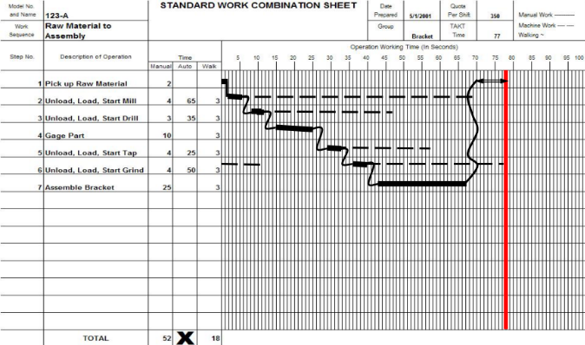
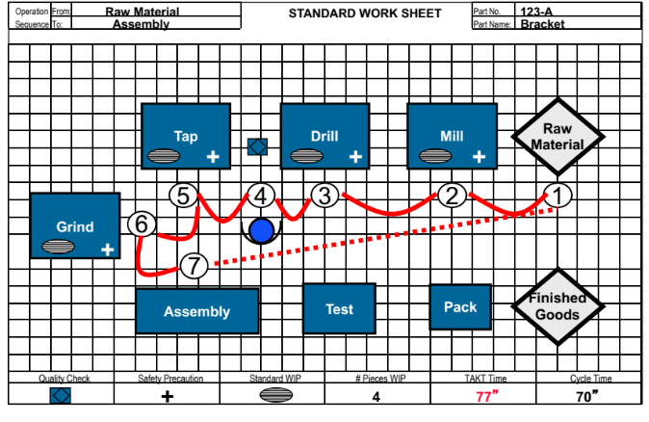
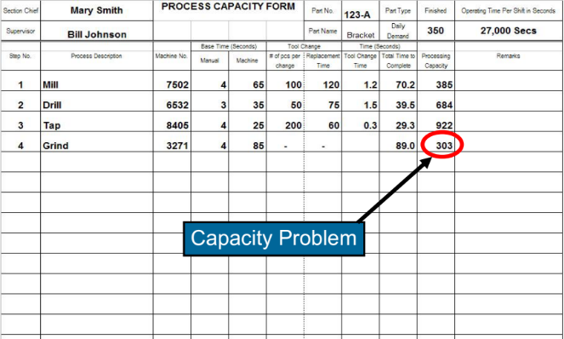
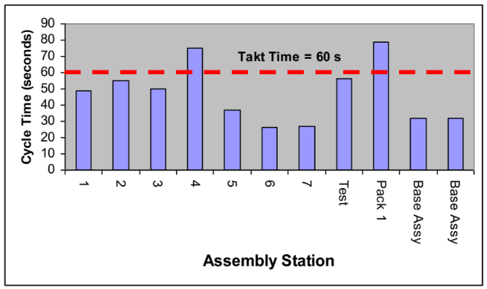
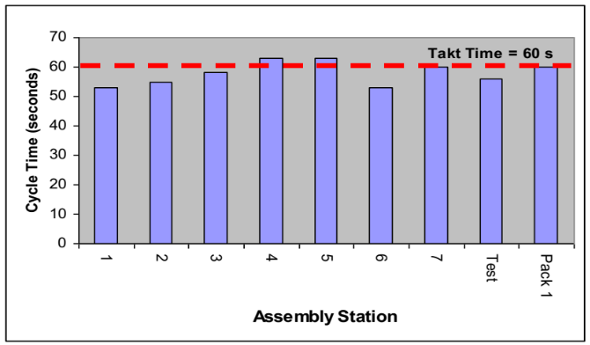
Required Kaizen Documentation - Standard Work
4
Note: Show sample of SW Combo Sheets. Time Observation Sheets (not shown) do not need to be included in the presentation)
Standard Work Combination Forms
Standard Work Sheet
Process Capacity Form
Operator Loading Charts - Before & After

Slide 9
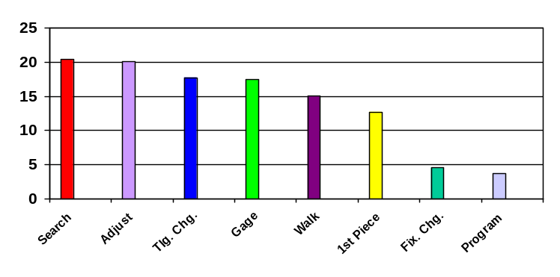
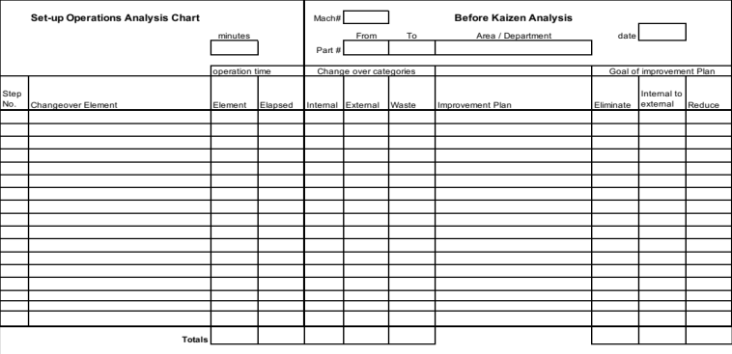
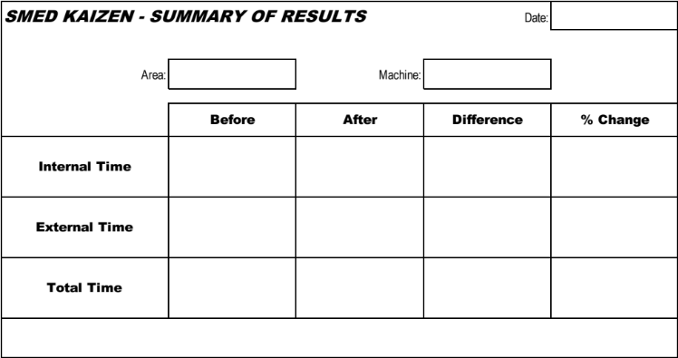
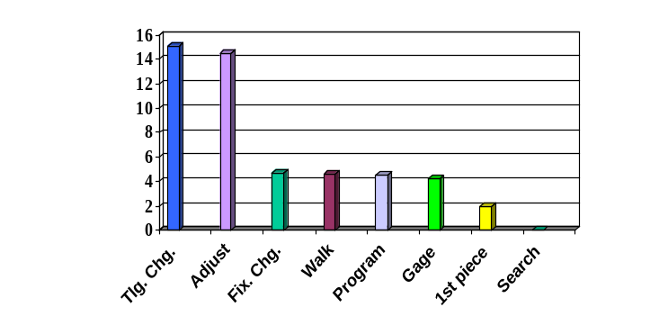
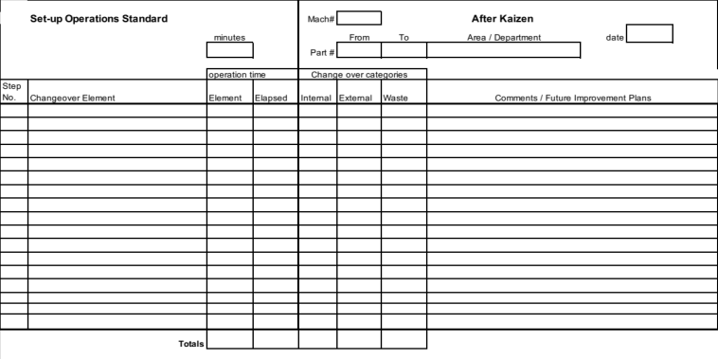
4
Required Kaizen Documentation - SMED
Set-up Pareto - BEFORE
Set-up Analysis Form - BEFORE
SMED Kaizen Results Summary
Set-up Pareto - AFTER
Set-up Analysis Form - AFTER

Slide 10
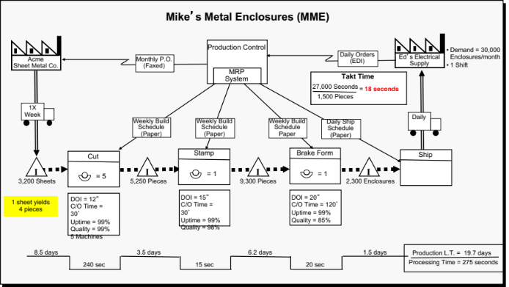
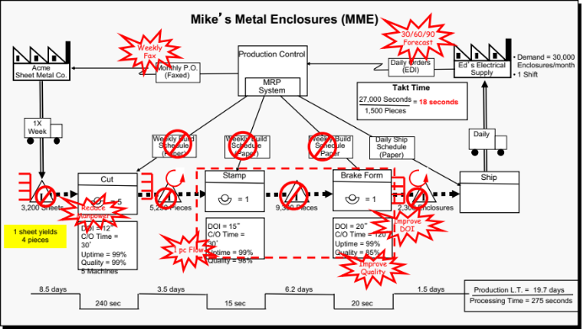
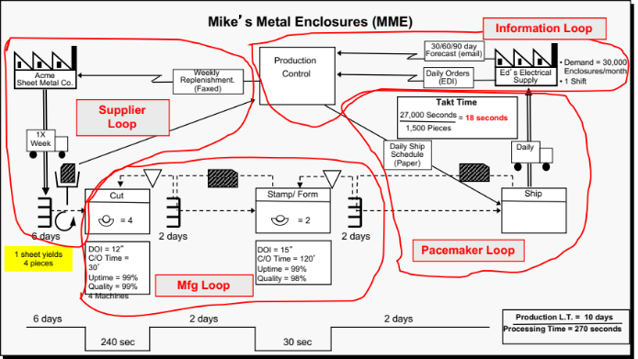
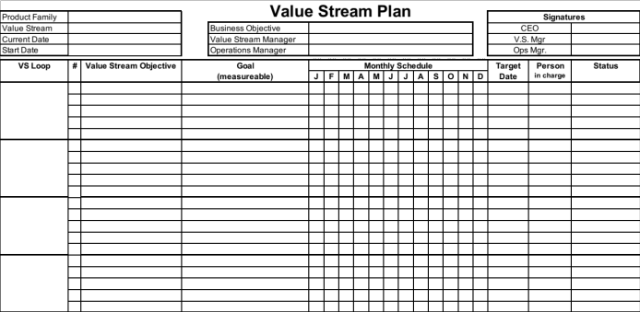
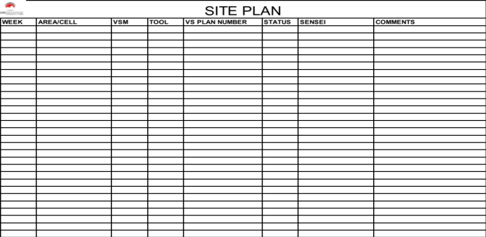
4
Required Kaizen Documentation
- Value Stream Mapping
Current State VSM
Interrogated Current State VSM
Future State VSM
Value Stream Plan
Site Plan

Slide 11
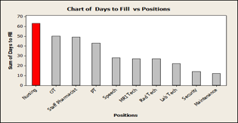
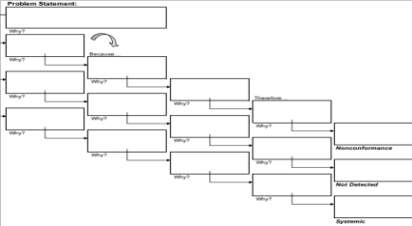
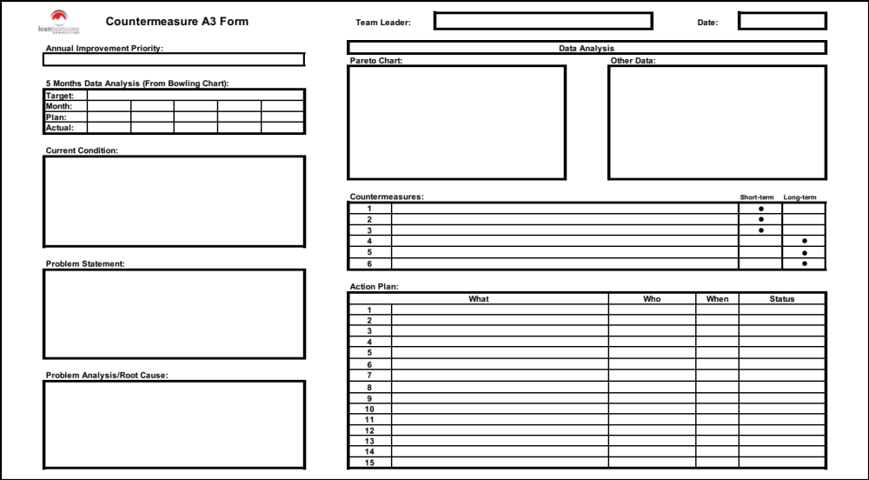
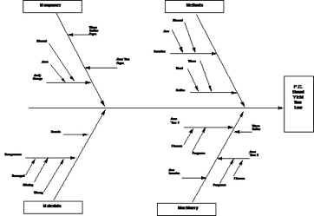
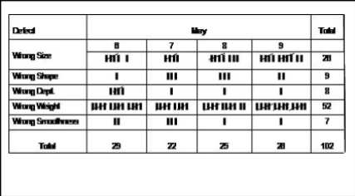
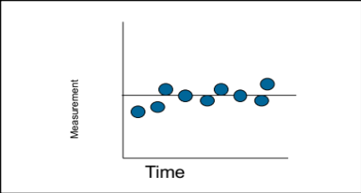
Required Kaizen Documentation - Problem Solving
4
Problem-Specific Tools as Required
Pareto Analysis
The 5 Whys?
Fishbone Analysis
Check Sheet
A3 Countermeasure Form - MANDATORY
Run Chart

Slide 12
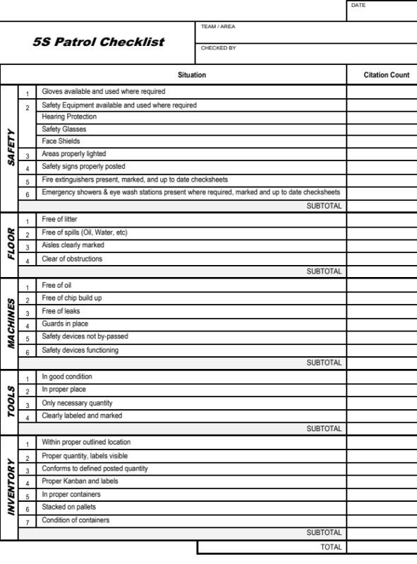
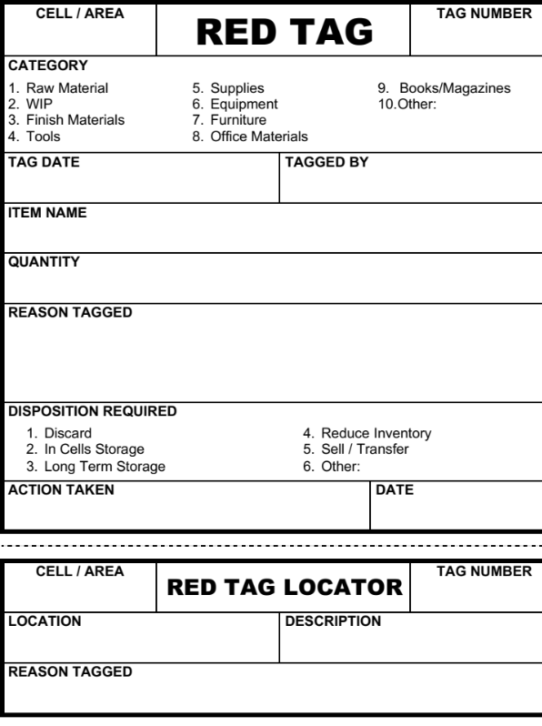
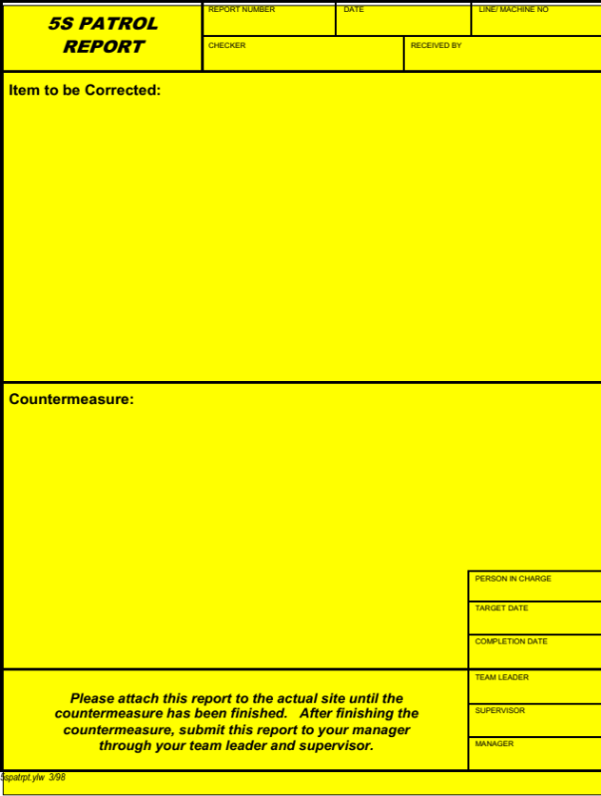
Required Kaizen Documentation - 5S
4
5S Patrol Check list
Red Tag Form
5S Patrol Report (Citation)

Slide 13
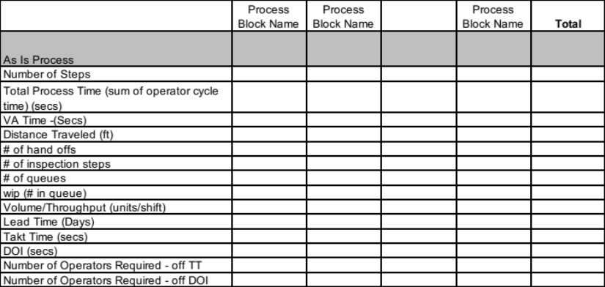
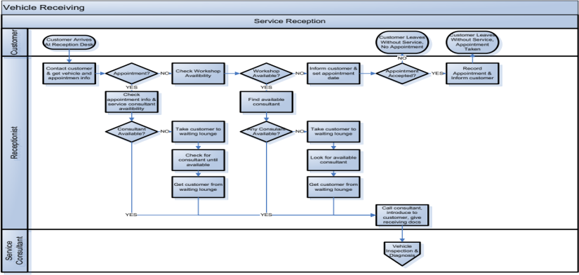

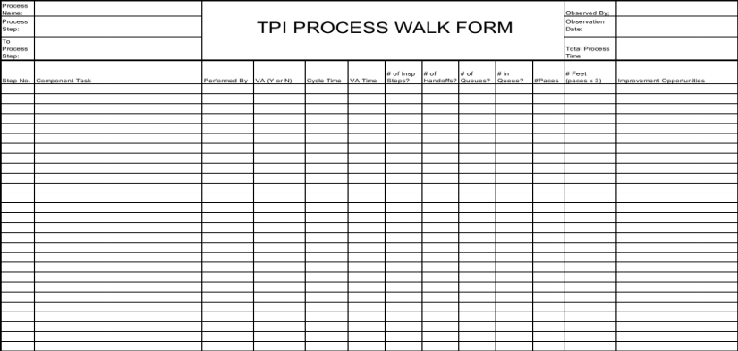
Required Kaizen Documentation - TPI
4
Process Data Summary - BEFORE
Process Map
Process Walk Form
Process Data Summary - AFTER
Select TPI Forms required based on the nature of the TPI event
(See Problem Solving Forms for Problem Solving/CEDAC Events)

Slide 14
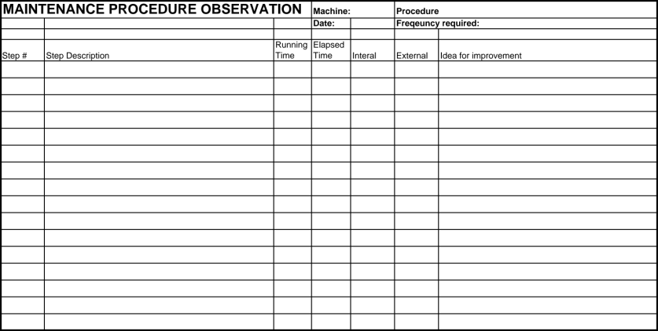
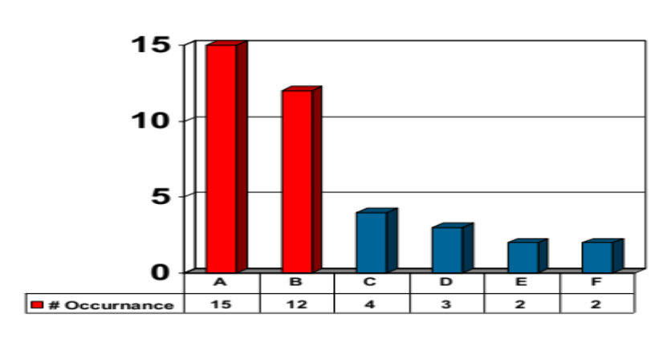
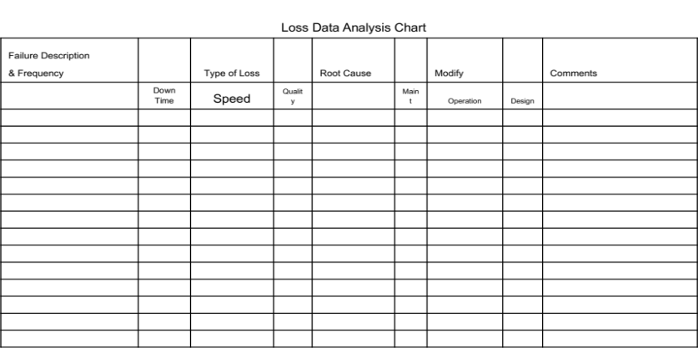
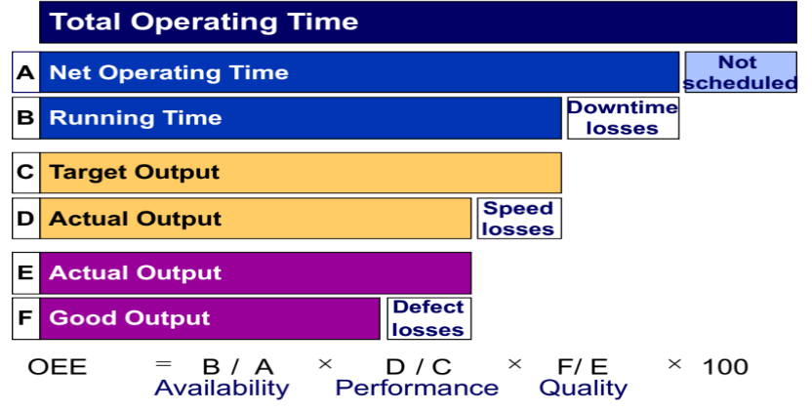
Required Kaizen Documentation - TPM
4
Maintenance Procedure Observation
Downtime Pareto Chart
Loss Data Analysis Chart
OEE Calculation

Slide 15
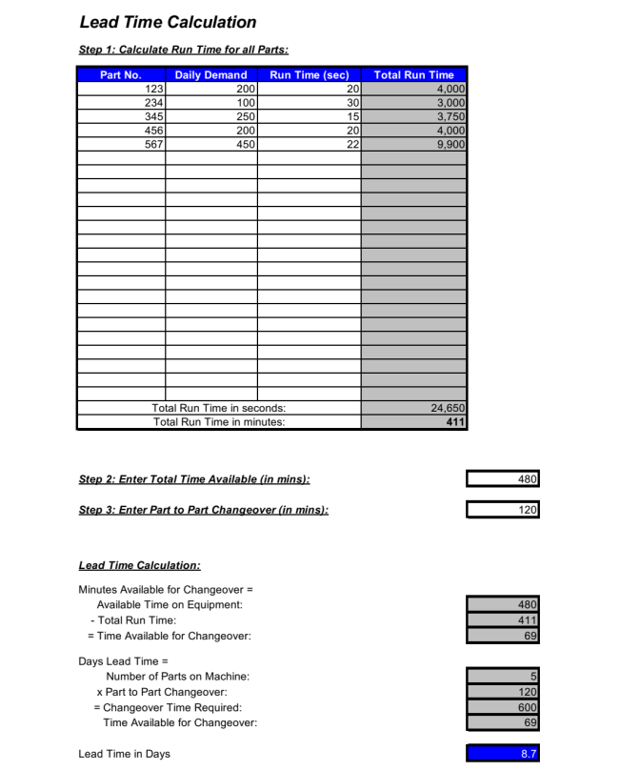
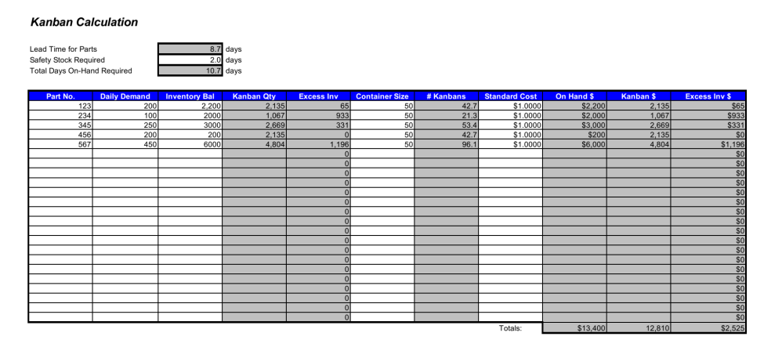
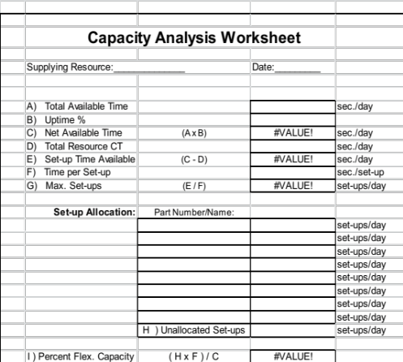
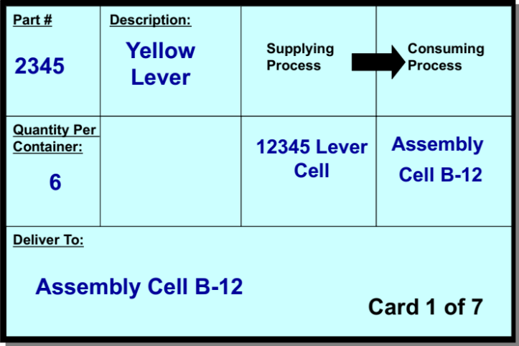
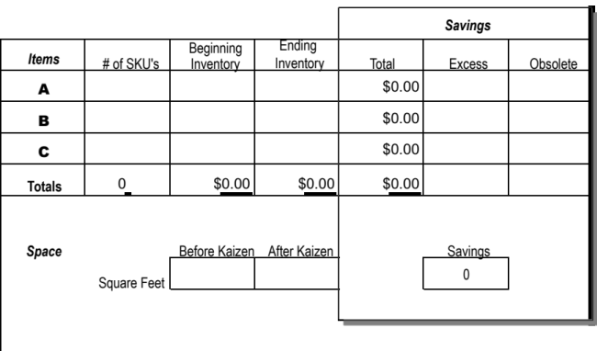
Required Kaizen Documentation - Kanban
4
Kanban Calculation
Capacity Analysis Worksheet
Lean Time Calculation
Inventory Improvement Results Form
Sample Kanban Card

Slide 16
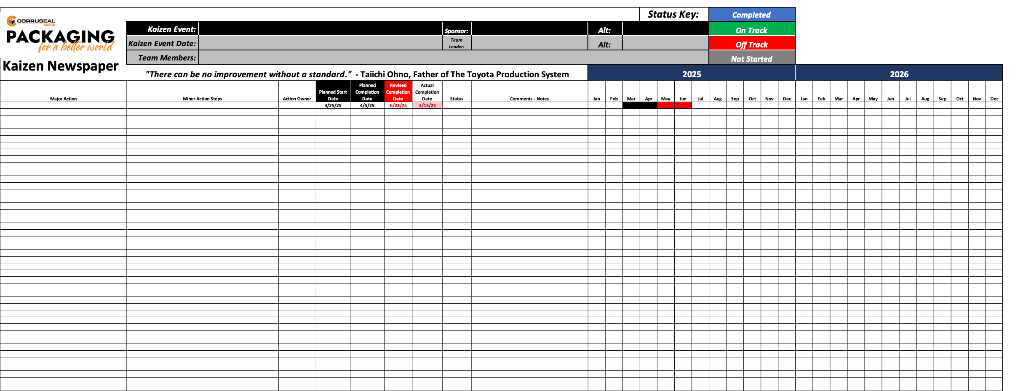
Required Kaizen Documentation - Kaizen Newspaper
5
To be Utilized for ALL Kaizen Events

Slide 17

Lessons Learned
6
Solicit feedback from team members as to the lessons learned or the “ah-ha” moments
Include praise, concerns, criticisms, etc.
No need to identify the author of the comment
Team Leader should present this section

Slide 18

Parking Lot
6
A list of future actions, Kaizen events, and focus areas that the Kaizen team recommends for future consideration that were outside the scope of the current Kaizen event.

